Slide 1
Recent Discussions in Cosmological Computation
Mike Stannett, University of Sheffield (m.stannett@dcs.shef.ac.uk)
New Worlds of Computation, LIFO, Orléans, 23 May 2011

Slide 2
Outline of talk
Cosmological computation (what is it?)
First-order relativity theories (Andréka et al.)
Recent focus: Closed Timelike Curves [CTCs]
  Do they exist?
  FTL does NOT entail CTCs after all
  Traversing a CTC: two distinct interpretations
  How can they be used?

Slide 3
Cosmological computation
Exploiting cosmological structures for computational purposes

Slide 4
What is it?
Using structural properties of cosmology for computational purposes.
  Malament-Hogarth spacetime
  Slow Kerr black holes
  Traversable wormholes
Typically involves two distinct observers
  User experiences finite proper time
  User sees Comp experience infinite proper time

Slide 5
First-order relativity theories
Geometric Logic Group @ Budapest
Hajnal Andréka, Judit Madarász, István Németi, Gergely Székely

Slide 6
SpecRel, GenRel, AccRel
First-order logical representations of various versions of relativity theory
Goals:
  What can be deduced within relativity theory?
  Given a result, which axioms are required in its proof?
  How far can the axioms be weakened and still generate cosmologically reasonable properties?

Slide 7
Typical axioms
Measurements take place in an ordered Euclidean field (one in which positive values have square roots)
  Need not be the real numbers
  Can include infinitesimals
Observers consider themselves to be stationary (world line = local time axis)
Each observer says that the speed of light is constant

Slide 8
Closed Timelike Curves
Do they exist? What kinds can there be? How might they be used?
Aren't they something to do with (banned) FTL travel? No!

Slide 9
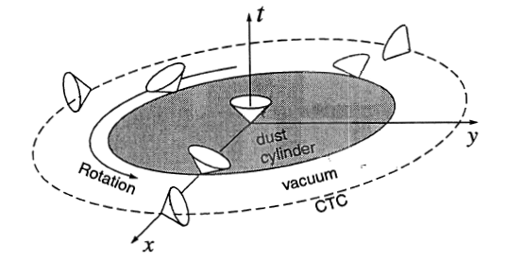
What is a CTC?
Van Stockum's Spacetime
From: Kip Thorne (1993) "Closed Timelike Curves". Tech report, CalTech GRP-340

Slide 10
Can they exist?
Not clear!
It's been argued that they're impossible (but based on the claim that something is "obviously" silly)
But they're present in solutions to Einstein's field equations (eg Gödel's universe)
... and if traversable wormholes exist...

Slide 11
Unexpected deduction
[sneak preview! not published yet]
It's generally claimed that FTL travel would necessarily result in time travel (i.e. CTCs) being possible
We have one theory in which FTL is possible, but it doesn't lead to CTCs.
Therefore: FTL does NOT entail CTCs.

Slide 12
Two models of CTCs
VERSION 1
If we revisit a past event, that event is in our past, and hence fixed. We have no choice but to repeat our earlier actions. No paradoxes.
VERSION 2
We don't need to repeat earlier actions. Does this necessarily entail paradoxes? No!

Slide 13
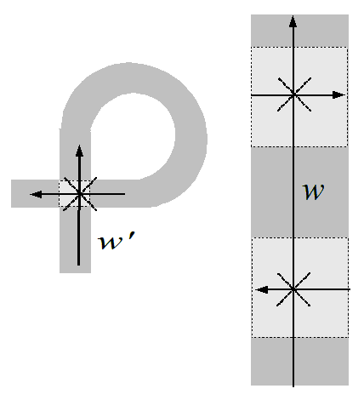
Single-traversable CTCs
In this ribbon universe, we revisit a past event, but our space and time axes have been switched over, so we cannot re-traverse the loop without travelling FTL.

Slide 14
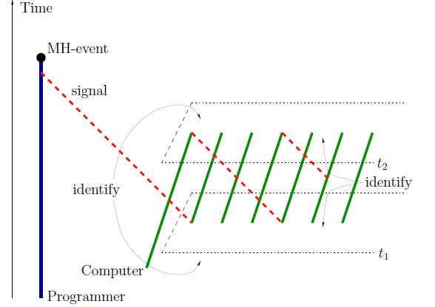
CTC Computation
Andréka et al. (2011, forthcoming)

Slide 15
CTCs and entropy
If a computer traverses a CTC and go back to an earlier state, how did it manage to recover its lost information?
It must be stored somewhere - in the CTC?
By considering a computation occurring in a CTC, we deduce
  Either: CTCs have entropy (just like BHs)
  Or: CTCs have failsafe mechansms preventing lossy computations being initiated

Slide 16
Summary

Slide 17
Is any of this relevant?
We cannot say for certain whether any of the cosmological schemes is definitely feasible in our own universe. [ditto re.Turing machines]
BUT the very fact that they might be feasible suggests that basic assumptions concerning computation need to be reconsidered
We cannot simply assume that the Church-Turing Thesis extends to physical devices. The underlying structure of physics matters.

Slide 18
Thanks for listening :)
Find out more at the HyperNet 11 / Physics &Computation 2011 Workshops, at UC2011, Turku, Finland, June 2011.

